Slide 1

AUTOMATED SMART STREET LIGHT FAULT DETECTION & RESPONSE SYSTEM
EC3811 - PROJECT WORK
BATCH NO: 04
Team Members
Chandru S 412622106002
Keerthika T 412622106011
Prem Arvinth G 412622106016
Under the Guidence of
Mr.Mohanasundaram , Assistant Professor ECE Dept, SVCT

Slide 2

OUTLINE
Objectives
Introduction
Problem Statement
Proposed System
Existing System vs Proposed System
Literature Survey
Block Diagram
Methodology
Components Used
Simulation Diagram
Hardware
Web Interface
Conclusion

Slide 3
OBJECTIVES
To design a cost-effective row-wise streetlight monitoring system.
To reduce hardware cost and system complexity.
To enable automatic fault detection and response.

Slide 4
INTRODUCTION
Street lighting plays a vital role in ensuring road safety, visibility, and security in both urban and rural areas.
Traditional streetlight systems depend on manual inspection, leading to delayed fault detection and higher maintenance effort.
Common issues such as lamp failure, power fluctuations, and low illumination are not identified in real time.
Existing IoT-based solutions improve automation but require multiple components per light, increasing cost and complexity.
There is a need for a scalable, cost-effective, and efficient monitoring system for large-scale deployment.

Slide 5
PROBLEM STATEMENT
Conventional streetlight systems rely on manual inspection or public complaints. This leads to delayed fault detection and increased maintenance time.
Pole-wise IoT systems use separate components for each streetlight. This increases hardware cost and system complexity.
Continuous data transmission from every pole is unnecessary. It creates higher network traffic and processing load.
Faults like lamp failure and overload are not detected instantly. This results in energy wastage and reduced public safety.
There is no scalable and cost-effective monitoring approach. Especially for large-scale and rural streetlight deployments.

Slide 6
PROPOSED SYSTEM
ROW-WISE MONITORING ARCHITECTURE Uses a centralized ESP32 controller to monitor a group of streetlights instead of individual pole-based systems, reducing hardware complexity and improving system management.
REAL-TIME FAULT DETECTION Continuously analyzes voltage and current parameters of the entire row to detect faults such as lamp failure, overload, open circuit, and short circuit conditions.
COST-EFFECTIVE AND SCALABLE DESIGN Eliminates redundant components like separate controllers and communication modules for each pole, reducing cost, minimizing data transmission, and enabling easy large-scale deployment.

Slide 7
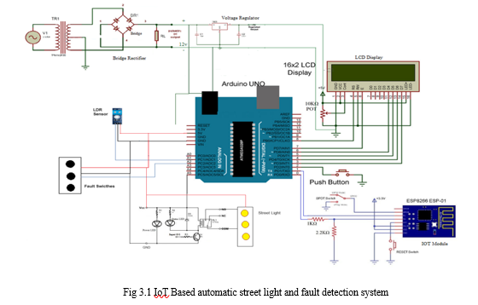
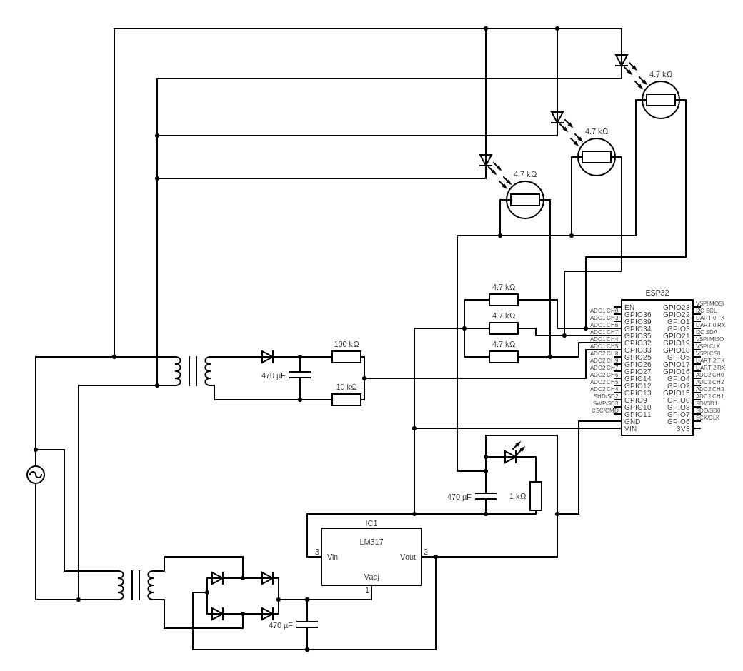
EXISTING SYSTEM
PROPOSED SYSTEM

Slide 8
LITERATURE SURVEY
S.No | Author / Year | Title | Key Contributions | Inference | Improvements in Your Project
1 | Shaheen et al., 2026 | Model Predictive Control for Adaptive Energy-Efficient Street Lighting | Uses MPC for adaptive lighting; improves energy efficiency | High computational complexity | Uses simple real-time fault detection with low-cost system
2 | Bruno et al., 2023 | Fast Frequency Support Through LED Street Lighting | Uses LED lighting for grid frequency control | Focus on grid, not fault detection | Focuses on fault detection and monitoring
3 | Ahmed et al., 2022 | AI-Based Fault Detection in Smart Grids | Uses ML models for predictive fault detection | Complex and high cost | Uses threshold-based simple detection (current + LDR)
4 | Kumar et al., 2021 | IoT-Based Smart Street Lighting System | Uses IoT for automated streetlight control | No proper fault detection | Adds row-wise fault monitoring system
5 | Thungtong et al., 2021 | Web-Based Control System for Street Lighting | Uses NB-IoT and web-based control | Only scheduling, no real-time detection | Provides real-time fault detection and response

Slide 9
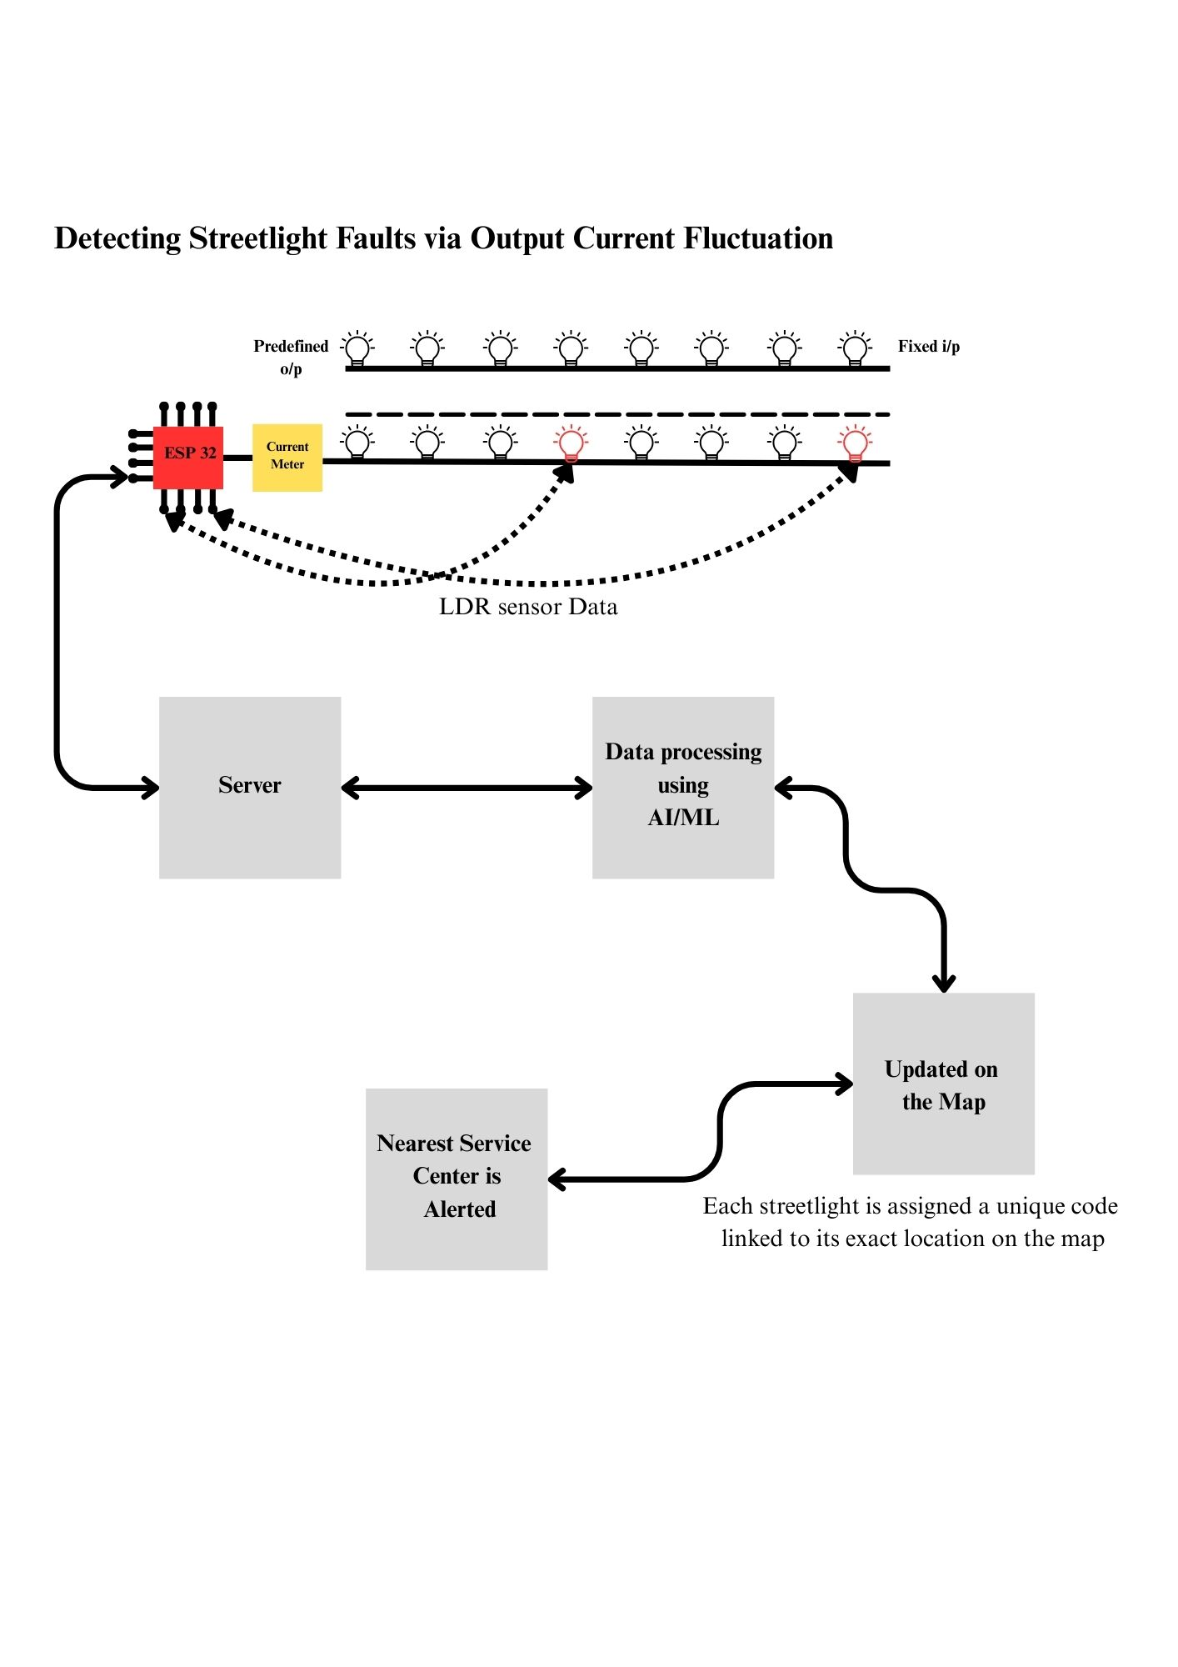
BLOCK DIAGRAM
Our system monitors the total output current of a streetlight row.
Any abnormal fluctuation from the predefined current range indicates a fault.
The ESP32 detects this deviation, sends the data to the server, updates the fault location on the map, and alerts the nearest service center for immediate action

Slide 10
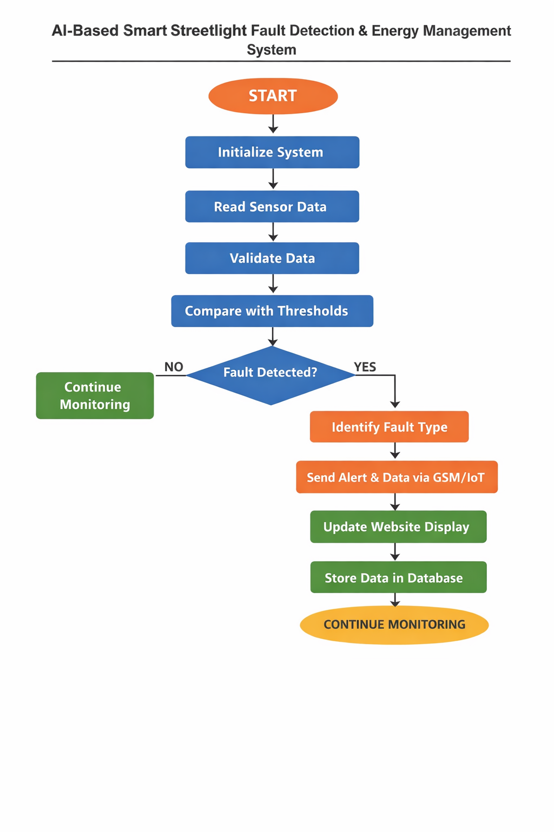
METHODOLOGY
The software continuously initializes and monitors the system by reading real-time sensor data such as output current and LDR values. It validates the data and compares it with predefined threshold limits to identify abnormal current fluctuations.
If a fault is detected, the system classifies the fault type and immediately sends an alert through Wifi_Module to the server.
The fault location is updated on the dashboard, the data is stored in the database for future analysis, and the system automatically resumes real-time monitoring to ensure uninterrupted operation

Slide 11
COMPONENT USED
S.No | Component | Parameter | Threshold | Function
1 | LED Streetlight | Power Consumption | 10W | Provides roadway illumination with high energy efficiency
2 | LDR Sensor (GL5528) | Ambient Light Intensity | Day/Night Threshold | Enables automatic ON/OFF control based on light conditions
3 | Current Sensor (ACS712) | Line Current | < 0.05 A or > 0.5 A | Detects lamp failure, overload, or abnormal current fluctuation
4 | ESP32 (WROOM 32) | Sensor Input Values | Beyond defined thresholds | Processes data and controls the monitoring system
5 | Power Supply Unit | Input Voltage | 5V / 12V Regulated | Provides stable power to controller and sensors
6 | Server / Cloud Platform | Fault Data | Real-Time Monitoring | Stores data and updates dashboard display

Slide 12
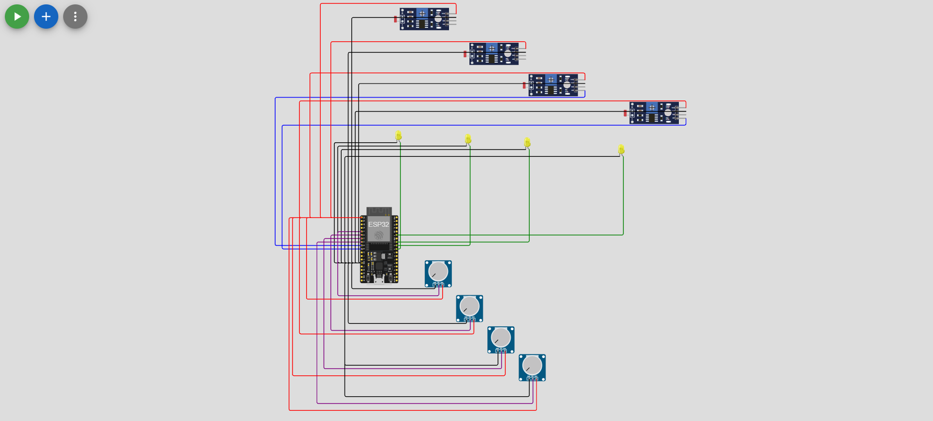
SIMULATION DIAGRAM

Slide 13
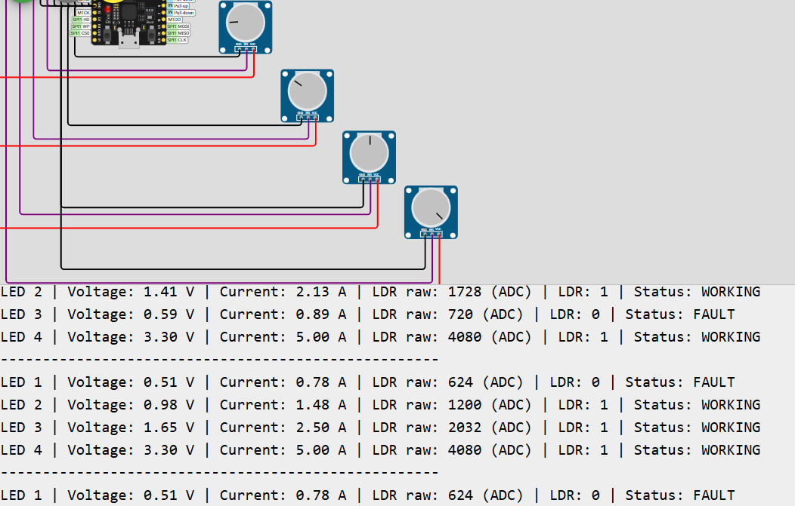
SIMULATION OUTPUT

Slide 14
SIMULATION OUTPUT
Displays real-time Voltage (V), Current (A), and LDR values for each streetlight.
Formulas Used: Voltage = (ADC × 3.3) / 4095 Current = (Voltage / 3.3) × 5A LDR raw = Brightness × 16
Threshold Value = 1000 Chosen as minimum brightness level to ensure proper illumination and avoid false fault detection.
If LDR raw < 1000 → insufficient brightness → FAULT If LDR raw ≥ 1000 → normal brightness → WORKING
Example from output: LDR = 624 (<1000) → FAULT LDR = 4080 (>1000) → WORKING

Slide 15
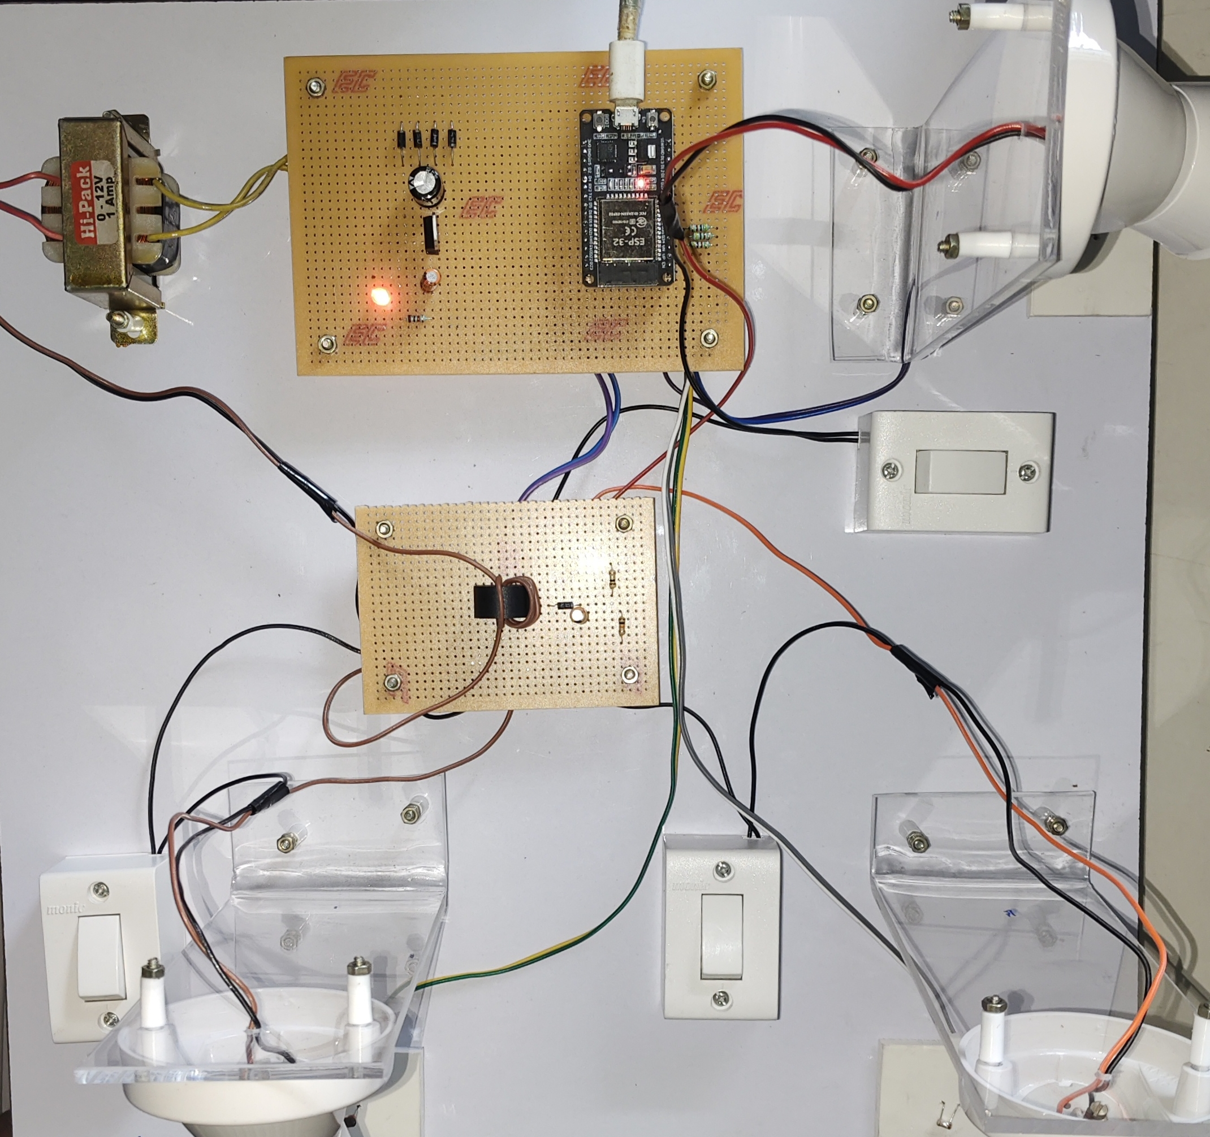
HARDWARE

Slide 16
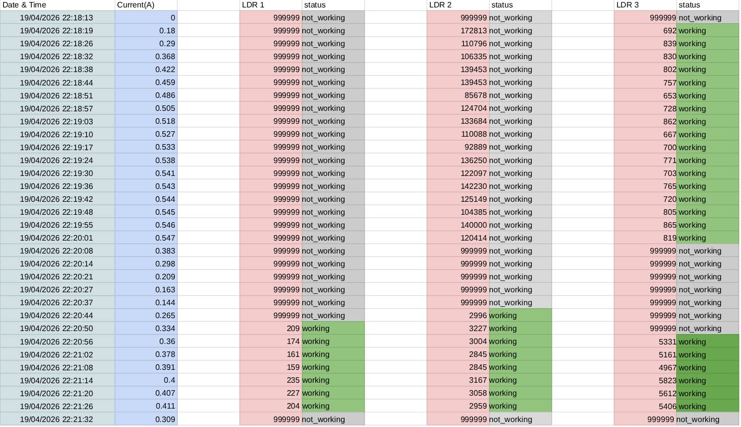
OUTPUT

Slide 17
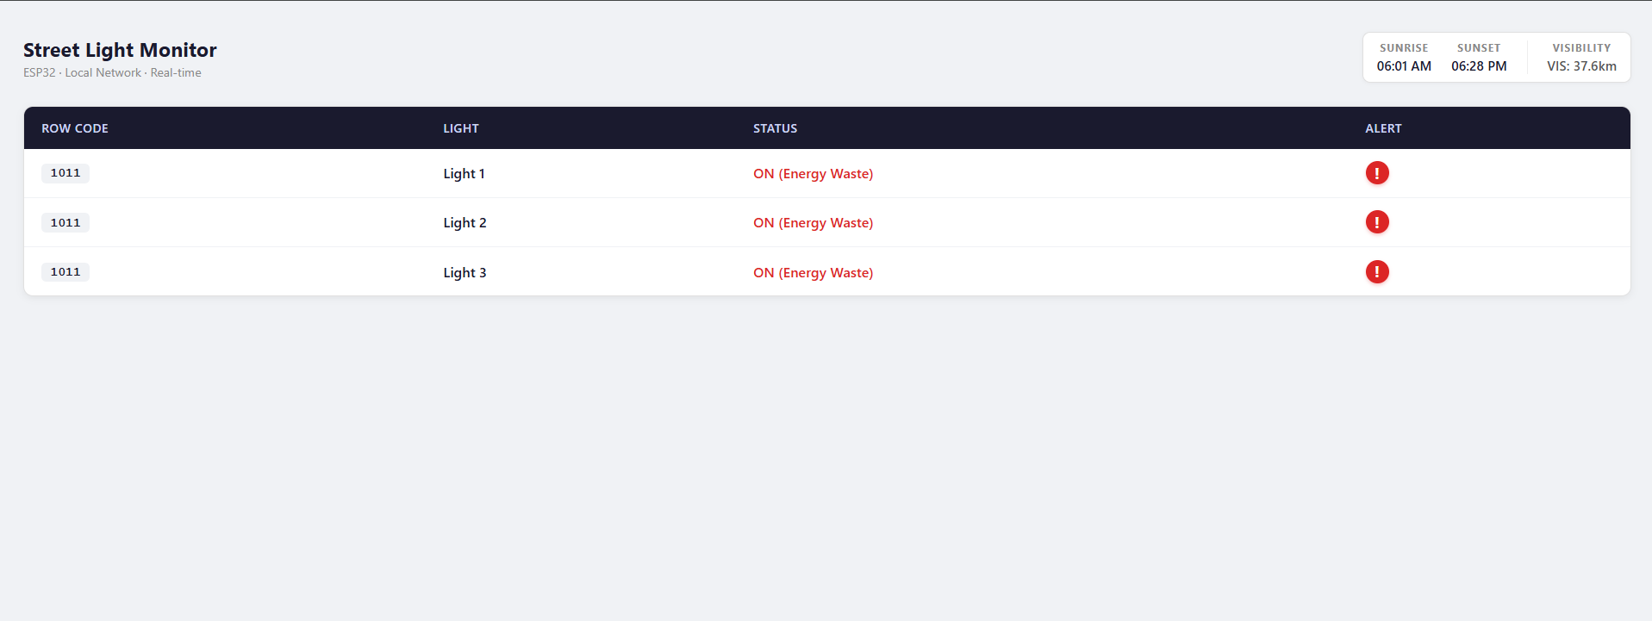
Web-Based Streetlight Monitoring Interface

Slide 18
CONCLUSION
Row-wise monitoring approach reduces the number of sensors and controllers required.
System accurately detects faults using current and brightness (LDR) threshold analysis.
Reduces overall cost, power consumption, and hardware complexity compared to existing systems.
Minimizes unnecessary data transmission and improves system efficiency.
FUTURE SCOPE
Integration with cloud platforms for centralized monitoring and data storage.
Integration with smart city infrastructure and automated energy management systems.
Enhancement with adaptive lighting control based on traffic and environmental conditions.

Slide 19
REFERENCE
[1] Abdelaziz, Amr Y., et al. "Artificial Intelligence Techniques for Fault Diagnosis in Electrical Power Systems: A Review." International Journal of Electrical Power & Energy Systems, vol. 120, 2020, p. 106008.
[2] Alhelou, Hassan Haes, et al. "A Survey on Power System Blackout and Cascading Events: Research Motivations and Challenges." Energies, vol. 12, no. 4, 2019, p. 682.
[3] Arif, Anwaar, et al. "Fault Detection and Localization in Smart Grids Using Machine Learning and Computational Intelligence: A Survey." Energies, vol. 14, no. 4, 2021, p. 985.
[4] Aziz, Tariq, et al. "A Review on Artificial Intelligence-Based Techniques for Fault Diagnosis in Power Electronics and Electrical Machines." Energies, vol. 13, no. 18, 2020, p. 4813.
[5] Borges, Cláudio L. T., et al. "A Comprehensive Review on Phasor Measurement Unit-Based Fault Location Approaches in Transmission Lines." Electric Power Systems Research, vol. 189, 2020, p. 106602.
[6] Chen, Chen, et al. "Machine Learning Based Fault Detection in Power Systems." IEEE Transactions on Smart Grid, vol. 7, no. 5, 2016, pp. 2564–2573.
[7] Ding, Tao, et al. "Fault Detection, Classification, and Location for Transmission Lines and Distribution Systems: A Review on the Methods." High Voltage, vol. 1, no. 1, 2016, pp. 25–33.
[8] Du, Wei, et al. "Deep Learning-Based Fault Detection and Isolation in Industrial Processes." IEEE Transactions on Industrial Informatics, vol. 16, no. 5, 2020, pp. 3168–3177.
[9] Gao, Feng, et al. "A Review on Fault Diagnosis Methods for Power Electronic Converters." IEEE Transactions on Power Electronics, vol. 32, no. 7, 2017, pp. 5996–6014.
[10] Ghayoor, Ali, et al. "A Comprehensive Review on Fault Diagnosis and Protection Methods for Microgrids." Energies, vol. 13, no. 16, 2020, p. 4095.
[11] Gómez, José R., et al. "A Review on Intelligent Fault Diagnosis Techniques in Power Transmission Systems." Energies, vol. 13, no. 22, 2020, p. 6004.
[12] Hajipour, Ehsan, et al. "A Review on Fault Detection and Diagnosis Techniques: Applications in Power Systems." Journal of Electrical Engineering & Technology, vol. 15, 2020, pp. 1859–1873.
[13] Hussain, Sadia, et al. "A Review on Machine Learning and Deep Learning Applications for Smart Grid Fault Detection." Energies, vol. 14, no. 9, 2021, p. 2387.

Slide 20
THANK YOU

